Slide 1
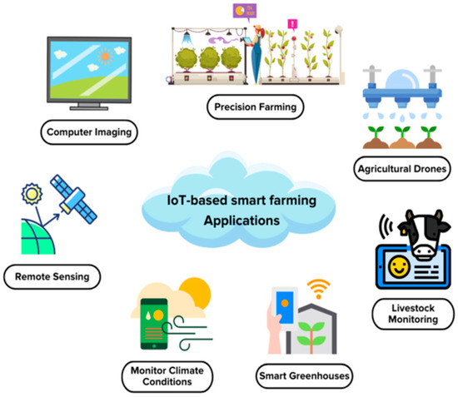
Precision Agriculture & The IoT Revolution
The Problem: Traditional farming in districts like Swat and Mardan often relies on guesswork for irrigation and fertilization.
The IoT Solution: Deploying sensors to measure soil moisture, pH levels, and NPK (Nitrogen, Phosphorus, Potassium) values in real-time.
Data-Driven Decisions: Using this high-resolution data to provide specific "prescriptions" for each patch of an orchard, reducing waste and increasing yield.

Slide 2
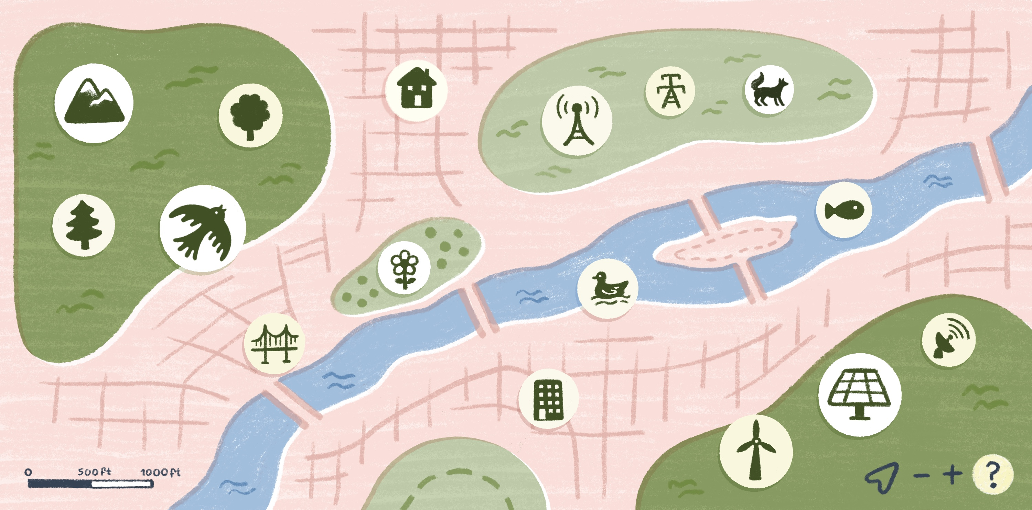
Satellite Imagery & GIS (The View from Above)
Large-Scale Monitoring: While sensors cover meters, satellites cover kilometers.
GeoPandas: A specialized tool that allows us to treat geographical shapes (districts, farms) like data tables.
Crop Health (NDVI): Using specific light wavelengths from satellite data to determine if a crop is healthy or stressed before the damage is visible to the human eye.

Slide 3
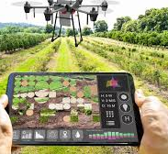
Yield Prediction & Harvest Forecasting
Economic Stability: Predicting the harvest totals for major KPK crops like Wheat, Tobacco, and Sugarcane helps government planners and farmers stabilize prices.
The Variables: Combining historical weather patterns (rainfall, heatwaves) with soil quality and historical harvest data.
Predictive Modeling: Moving from "What happened?" to "How many tons will we harvest in June?"

Slide 4
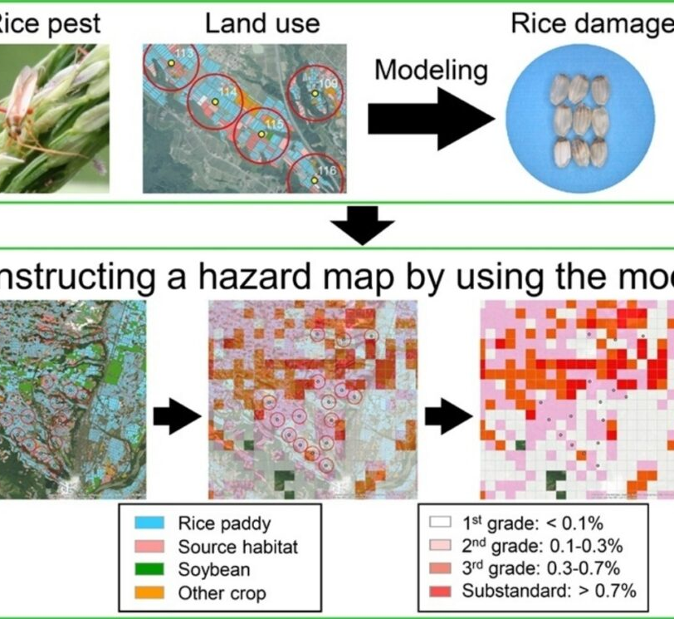
Spatial Mapping of Pests and Disease
Tracking the Spread: Pests like locusts or fungal diseases don't respect borders. Spatial analytics allows us to map the "front line" of an infestation.
Predictive Containment: By analyzing wind patterns and humidity, we can predict which district (e.g., Charsadda vs. Nowshera) is at risk next.
Resource Allocation: Sending pesticides and experts only to the areas identified as "High Risk" by the data model.

